Slide 1
ADVANCED JAVA PROGRAMMING
SEMINAR

Slide 2
Write a program to present an address book app that enables you to browse existing entries, add new entries and search for entries with a specific last name using prepared statements.
PROGRAM - 4

Slide 3
• Creating a main java file which is connected with other linked files • Creating linked files add, delete, search and print • Adding select options to select as per user need • Creating contact file where the data gets stored
STEPS INVOLVED:

Slide 4
Eclipse IDE for complete program
Software used

Slide 5
Main.java Add.java Search.java Print.java Delete.java
Java Files used

Slide 6
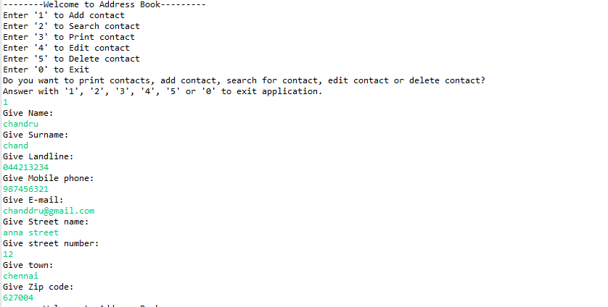
Adding

Slide 7
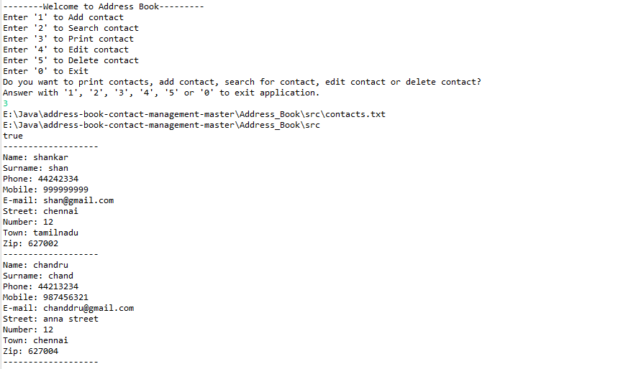
Printing all

Slide 8
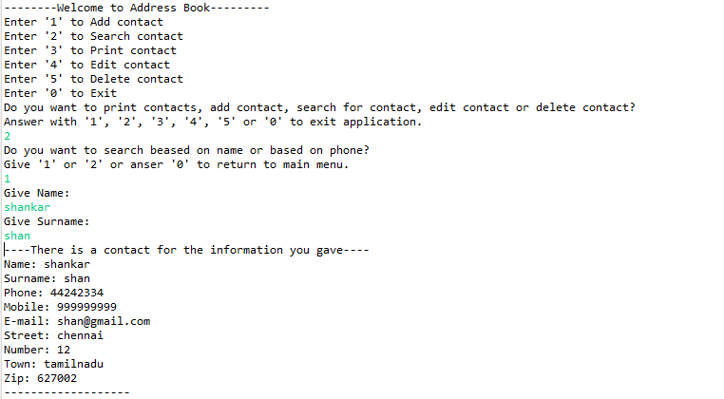
Searching a contact

Slide 9
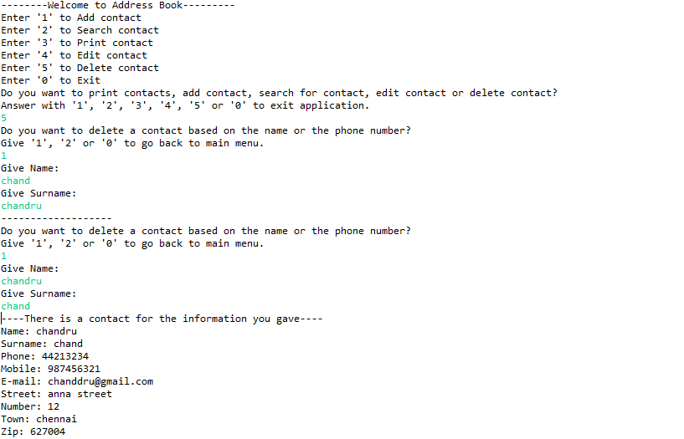
Deleting contact

Slide 10
Thank you

